Slide 1
Gender Prediction AND HATE SPEECH DETECTION With Textual Data Using Machine Learning
Project Guide : Dr. M.Sreelatha Madam Team Members
Batch Number : 01 J.V.Y.H. Lakshmi Narsitha(Y20CS069)
K.Durga Bhavani (L21CS199)
M.Kalyani (Y20CS105)

Slide 2
Contents
Abstract
Existing techniques and their limitations
Solutions proposed to the limitations
Algorithms
Datasets
Implementation Details
Results
Test Cases
Conclusion

Slide 3
Abstract
This paper utilized twitter data to investigate behavioural differences between male and female users on social media and also to detect hate speech and abusive content based on tweets posted by individuals. Using many Natural Language Processing and Machine Learning approaches, this paper they proposed a user gender identification method and hate speech detection method that considers both the tweets and the Twitter profile description of a user. Including the twitter profile description of a user significantly improves accuracy, by 10% approximately.

Slide 4
Existing techniques and their limitations
Only considering content of tweets
Dataset: The model utilizes Twitter data as its primary source, focusing on contents of tweets only for gender classification.
Approach: The model employs a combination of techniques, including Word2Vec and Logistic Regression (LR), to predict gender based on textual data and achieved overall accuracy of 57%.
Reference: Vashisth and Meehan conducted a study on gender prediction using Twitter data.
Limitations
Here the overall accuracy obtained is very low.

Slide 5
Only considering names of user
Dataset: The model utilizes a large dataset of gender-labelled Twitter users, focusing primarily on the names of users for gender classification.
Approach: The model explored the correlation between users' first names and their genders. They created a dataset of gender-labelled Twitter users and achieved an overall accuracy of 87%.
References: Liu et al. (2013), Vicente et al. (2015) and Alowibdi et al. (2013a), have employed similar approaches involving the creation of dictionaries of names classified by gender.
Limitations
A major limitation of this method is the prevalence of unisex names and the use of pet names or abstract nicknames by users, which makes a gender classification based on names alone difficult or impossible.

Slide 6
Only for small amount of data
Dataset: The model utilizes user-generated content from Twitter
Approach: This model proposed a method for gender classification using LIWC features extracted from user-generated content on Twitter. They achieved an accuracy of 76.1% on a dataset of 6000 users.
Reference: The method proposed by Alowibdi et al. (2013b) involves the use of LIWC features for gender classification, highlighting the linguistic patterns and word usage differences between genders in user-generated content.
Limitations
This model only considers very small dataset, this will not be useful for real world applications

Slide 7
Solutions proposed to the limitations
To make our model applicable real world we initially consider the Twitter Dataset which consists of 20050 rows and later we extended that dataset to 296108 rows.
We not only considered the content of tweets but also considered user profile description.
We compare the accuracy among considering tweets alone, user description alone and combining tweets and description with help of various ML algorithms and NLP techniques.
The best performing ML algorithm when combined with GloVE is Random Forest, achieving an accuracy of 80%. This accuracy level is higher in comparison to other published research that used the same base dataset.

Slide 8
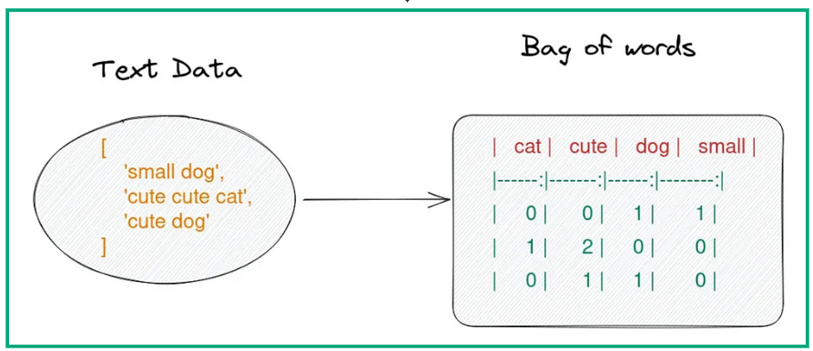
Algorithms Nlp Algorithms for data preparation
Bag of words
We cannot directly feed our text into that algorithm. Hence, Bag of Words model is used to preprocess the text by converting it into a bag of words, which keeps a count of the total occurrences of most frequently used words

Slide 9
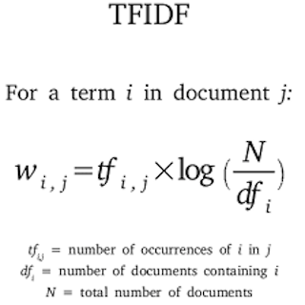
TF-IDF
TF-IDF is often used to transform text into vectors, where vectors are meant to represent the content of the text.
In document d, the Term Frequency represents the number of instances of a given word t.
Inverse document frequency is a measure of how common or uncommon a word is in a collection of documents

Slide 10
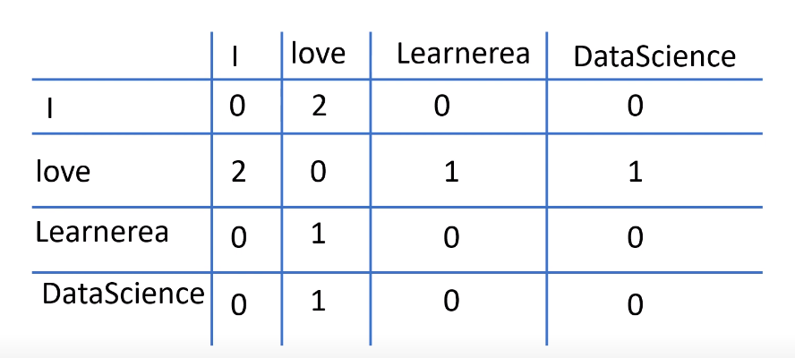
GLOVE
Example:
I love Learnerea
I love DataScience
Global Vectors for Word Representation, or GloVe for short, that generates vector representations, or embeddings, of words.
It derives the semantic relationship between words using word-word co-occurrence matrix.
In GloVe, we measure the similarity of the hidden factors between words to predict their co-occurrence count. We want to create vector representations that can predict their co-occurrence counts in the corpus also.

Slide 11
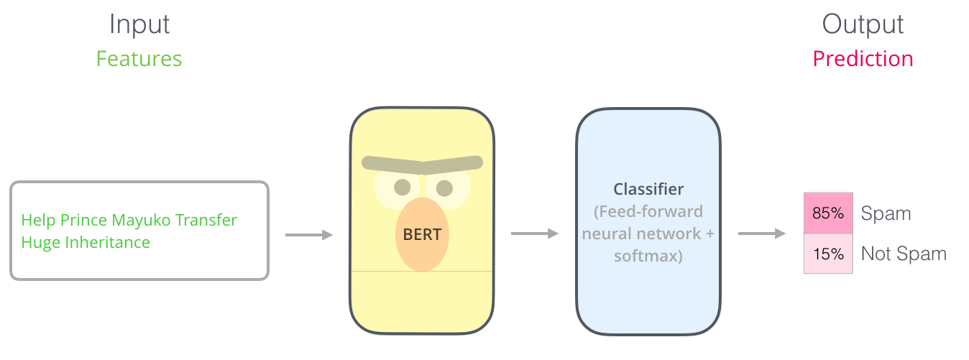
BERT
BERT, or Bidirectional Encoder Representations from Transformers, is a powerful NLP model based on the Transformer architecture.
BERT uses a multi-layer bidirectional transformer encoder to represent the input text in a high-dimensional space. That means it can take into account the entire context of each word in the sentence, which helps it to better understand the meaning of the text.
The tokenized text is fed into the BERT model, which produces contextualized embeddings, with particular emphasis on the token representation, encapsulating the overall meaning of the input sequence.
These embeddings serve as input features for traditional machine learning algorithms like SVM or Logistic Regression.

Slide 12
W2V
Word2Vec is a popular algorithm used for natural language processing and text classification. It is a neural network-based approach that learns distributed representations (also called embeddings) of words from a large corpus of text. These embeddings capture the semantic and syntactic relationships between terms, which can be used to improve text classification accuracy.
We can train a Word2Vec model using a tool such as Gensim. The model figures out how to represent words as vectors based on their use in the twitter dataset.
After training the Word2Vec model, you can represent each tweet as a vector by taking the average of the Word2Vec embeddings of the words. This makes a vector representation of the tweet that shows how the words fit together and what they mean.

Slide 13
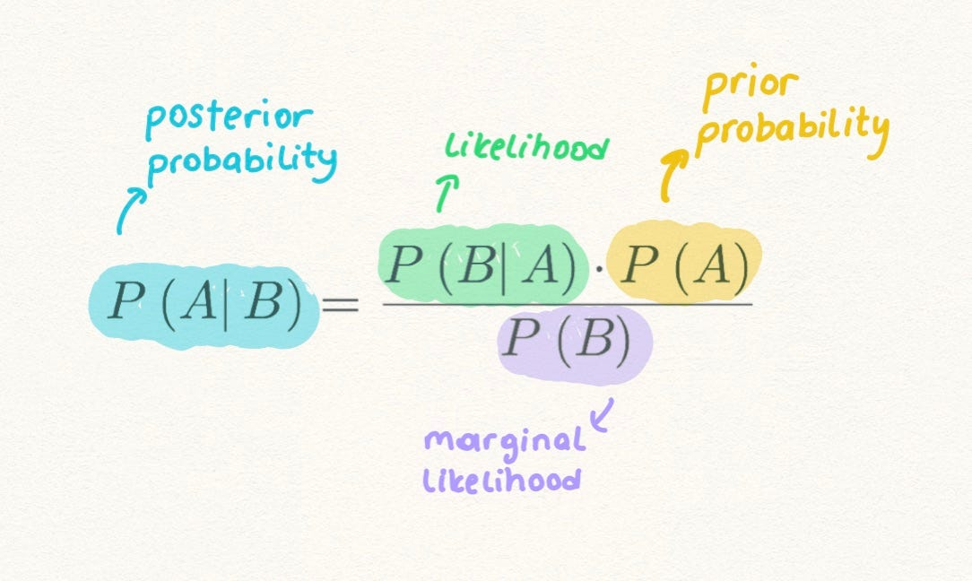
Machine Learning Algorithms
Naïve Bayes Classifier
It is a supervised learning algorithm based on bayes theorem for text classification.
It is a probabilistic classifier which means it performs prediction on the basis if probability of an object.
Based on the probability obtained we categorize the new data into existing class label.

Slide 14

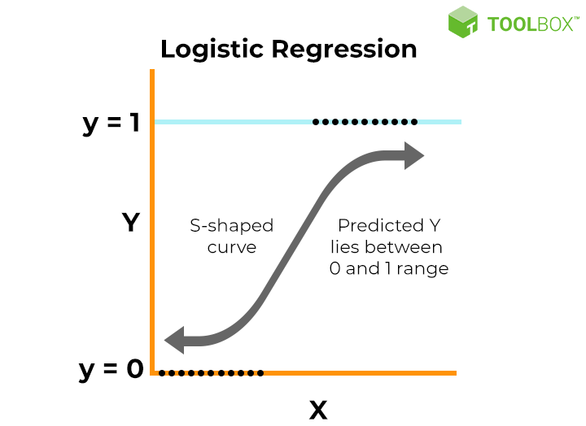
Logistic Regression
Logistic regression is a supervised machine learning algorithm used for binary classification tasks used to predict the probability that an instance belongs to a given class or not.
Logistic regression is used for binary classification(Male, Female) where we use sigmoid function, that takes input as categorical independent variables and produces a discrete probability value between 0 and 1.
It estimates the probability of an event occurring, based on a given dataset of independent variables(Content). Since the outcome is a probability, the dependent variable is bounded between 0 and 1.
If the logistic function value is greater than 0.5 (threshold value) then it gives probability 1 otherwise 0.

Slide 15

Decision Tree
It is a supervised learning algorithm and it is a graphical representation for getting all the possible solutions to a problem based on given conditions.
It is a tree-structured classifier where each internal node represents the features of the dataset and branch represents decision rules and leaf nodes represents final outcome.
To predict the class of the given dataset the algorithm starts from root node. It compares the values of root attribute with the record attribute, based on the comparison it selects an attribute, follows the branch and jumps to the next node.
This process continues for the next nodes also until it reaches the leaf node of the tree.
We calculate Entropy and information gain for attribute selection.

Slide 16
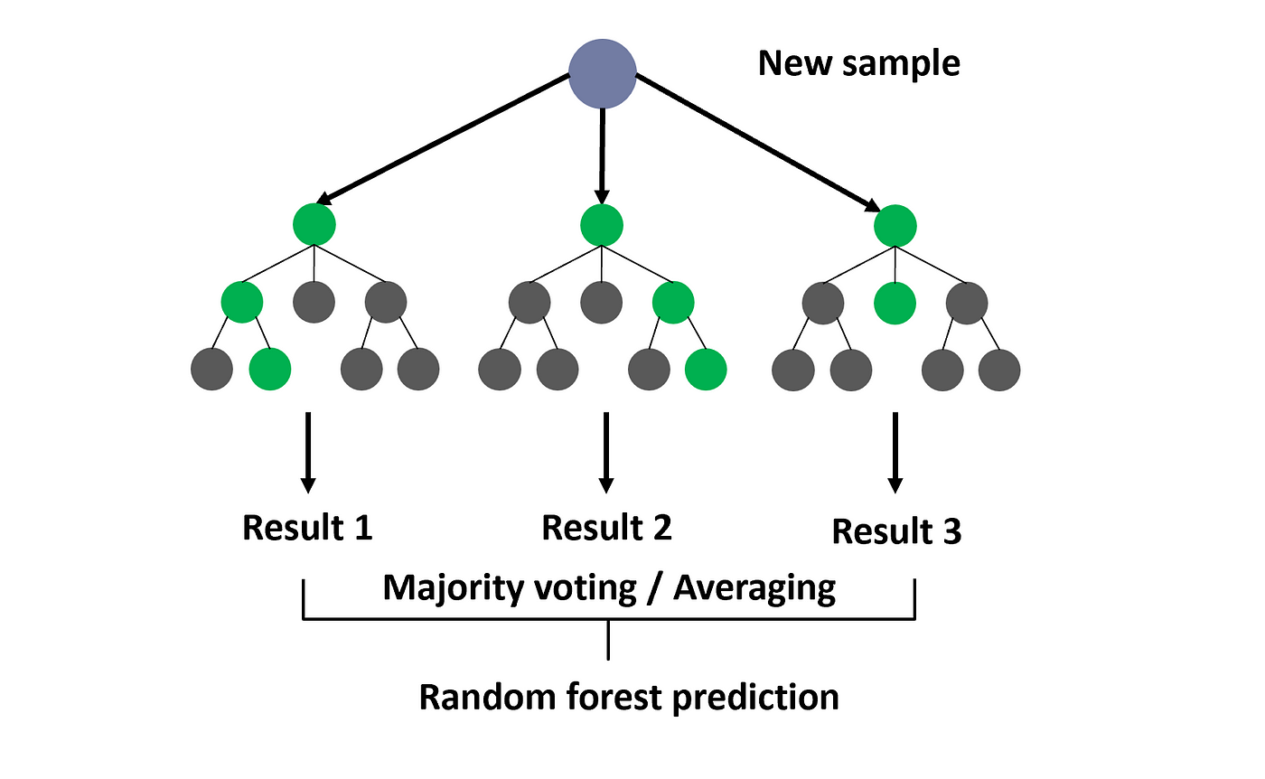
Random Forest
It is based on the concept of ensemble learning, which is a process of combining multiple classifiers to solve a complex problem and to improve the performance of the model.
This classifier contains number of decision trees on various subsets of given datasets and it takes the average to improve the predictive accuracy of that dataset.
Random forest takes the prediction from each tree and based on the majority votes of predictions, and it predicts the final output.
More number of trees in the forest leads to higher accuracy and prevents the problem of overfitting.
Individual decision trees may or may not predict the correct output. But combining all the trees predict the correct output.

Slide 17

Support Vector Machine
Support Vector Machine (SVM) is a powerful machine learning algorithm used for linear or nonlinear classification, regression, and even outlier detection tasks.
The main objective of the SVM algorithm is to find the optimal hyperplane in an N-dimensional space that can separate the data points in different classes in the feature space. The hyperplane tries that the margin between the closest points of different classes should be as maximum as possible. The dimension of the hyperplane depends upon the number of features. If the number of input features is two, then the hyperplane is just a line.

Slide 18
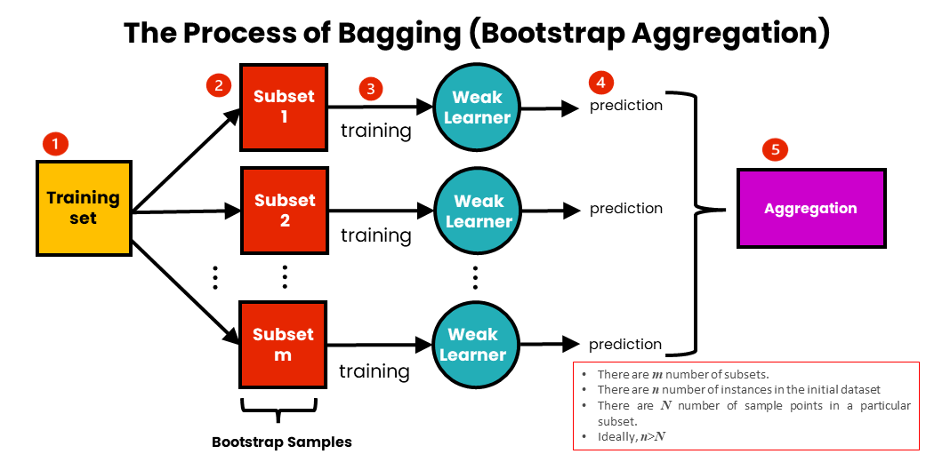
Bagging
Bagging, also known as Bootstrap aggregating, is an ensemble learning technique that helps to improve the performance and accuracy of machine learning algorithms. It is used to deal with bias-variance trade-offs and reduces the variance of a prediction model.
Here multiple base models are trained independently and in parallel on different subsets of the training data. Each subset is generated using bootstrap sampling, in which data points are picked at random with replacement. In the case of the bagging classifier, the final prediction is made by aggregating the predictions of the all-base model using majority voting. In the models of regression, the final prediction is made by averaging the predictions of the all-base model, and that is known as bagging regression.

Slide 19
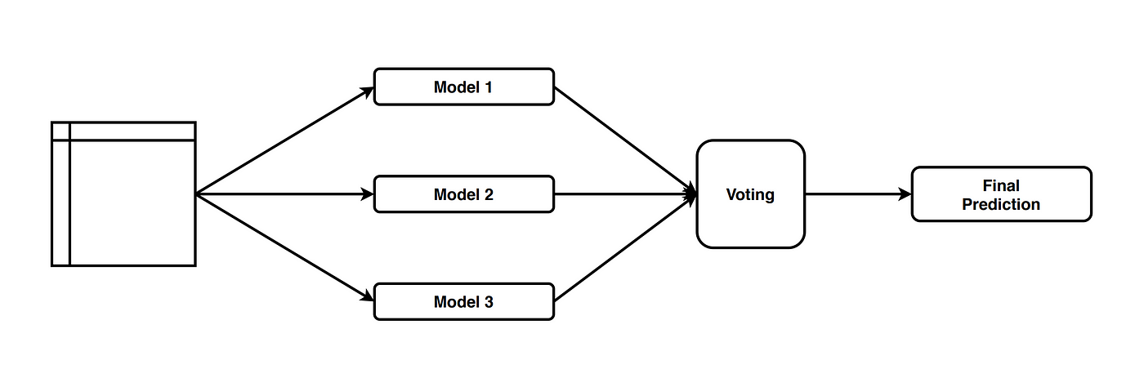
Voting Ensemble Classifier A Voting Classifier is a machine learning model that trains on an ensemble of numerous models and predicts an output (class) based on their highest probability of chosen class as the output. It simply aggregates the findings of each classifier passed into Voting Classifier and predicts the output class based on the highest majority of voting. The idea is instead of creating separate dedicated models and finding the accuracy for each them, we create a single model which trains by these models and predicts output based on their combined majority of voting for each output class.

Slide 20
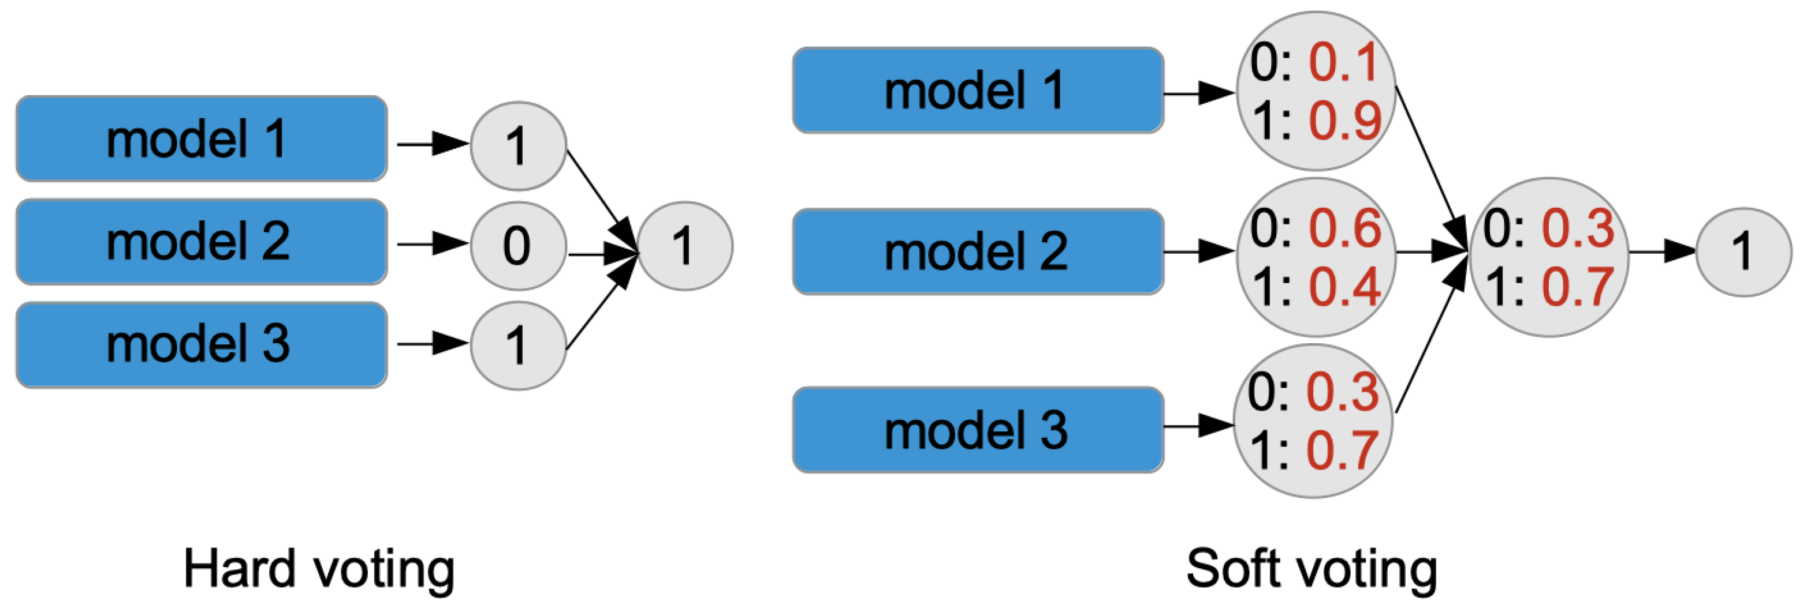
VCH
In hard voting, the predicted output class is a class with the highest majority of votes.
VCS
In soft voting, the output class is the prediction based on the average of probability given to that class.

Slide 21
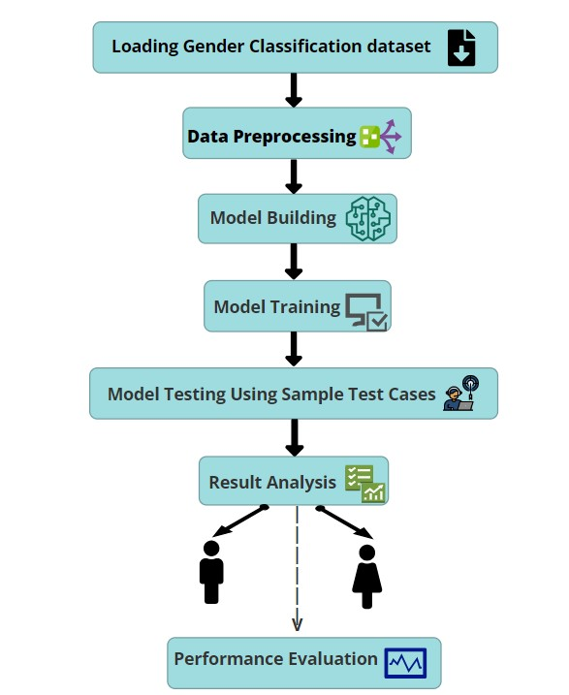
Algorithm Steps

Slide 22
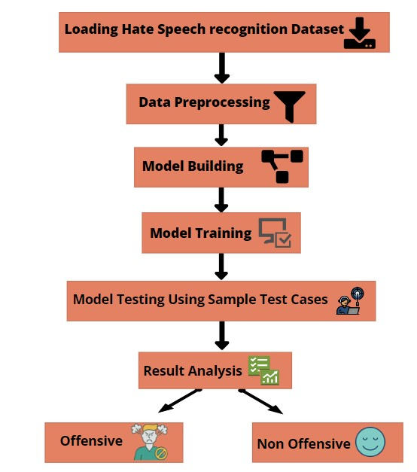

Slide 23
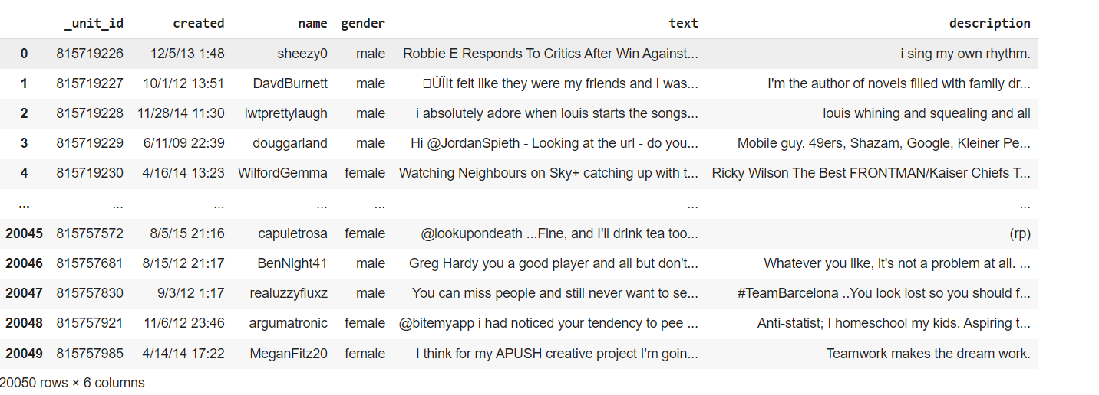
Datasets
Initially this paper consider the “The Twitter User Gender Classification” dataset is available on Kaggle and contains data for 20,050 users with one random tweet each. Each entry consists of the tweet’s textual content, the date it was posted, the username of the author, their gender, their profile description and some other columns.

Slide 24
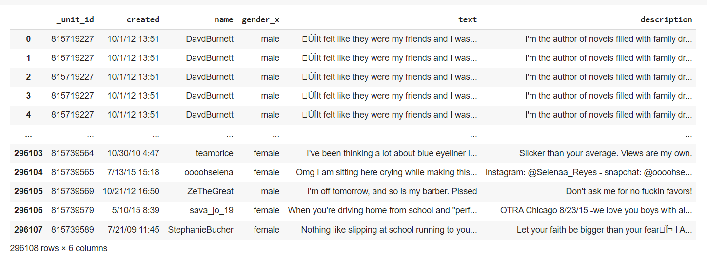
Later the dataset is expanded so that the extended dataset contain 296,108 rows.

Slide 25
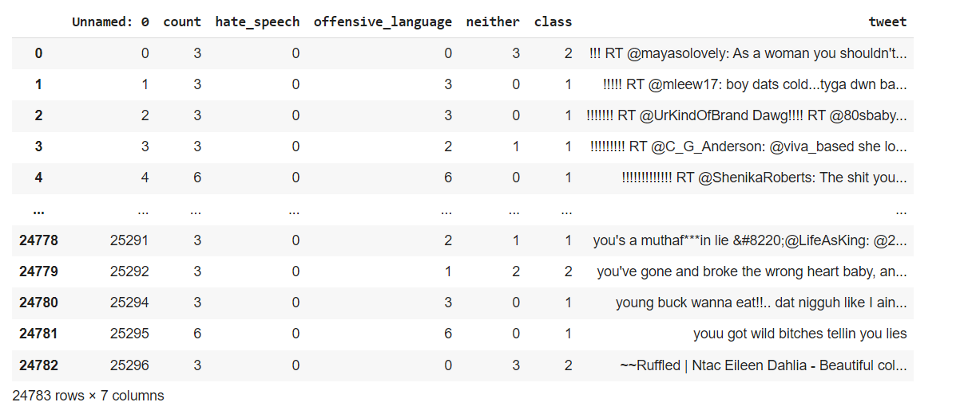
To detect the hate speech and abusive content we used hate speech and offensive language dataset from Kaggle

Slide 26
Implementation details a)Gender Prediction
Reading and Extending Dataset:
import pandas as pd
df1=pd.read_csv('/content/gender-classifier-DFE-791531.csv',encoding='latin')
df2 = pd.read_csv('/content/Processed-Tweets-Train.csv’)
merged_df=pd.merge(df1,df2, left_on='_unit_id', right_on='tweet_id', how='inner’)
df3=pd.read_csv('merged_file.csv')
df4=pd.read_csv('/content/Processed-Tweets-Test.csv')
merged_df1 = pd.merge(df1, df4, left_on='_unit_id', right_on='tweet_id', how='inner’)
df5=pd.read_csv('merged_file1.csv’)
tweet_df=[df3, df5]
result = pd.concat(tweet_df)

Slide 27
Data Cleaning:
data=edf[["_unit_id","created","name","gender_x","text","description"]]
#dropping null values in gender
data.dropna(subset=["gender_x"], inplace=True)
#dropping gender with brand and unknown
data.drop(data.loc[data["gender_x"]=="unknown"].index, inplace=True)
data.drop(data.loc[data["gender_x"]=="brand"].index, inplace=True)
data.dropna(subset=["description"], inplace=True)
#combing text and description
data["tweetdesc"]=data["text"]+" "+data["description"]

Slide 28
Preprocessing:
def preprocess_text(text):
text = text.lower() #1. Convert text into lower case
text = re.sub(r'[^\x00-\x7F]+', ' ', text)#2.Remove special,NON-ASCII characters
stop_words = set(stopwords.words('english’)) #3.Remove stopwords using NLTK
word_tokens = word_tokenize(text)
text = ' '.join([word for word in word_tokens if word not in stop_words])
text = re.sub(r'@\w+\s?', '', text) #4. Remove usernames starting with '@'
text = re.sub(r'@(\w+)', '', text)
text = re.sub(r'http\S+', '', text) # Remove URLs
text = re.sub(r'#\w+', '', text) # Remove hashtags
text = re.sub(r'RT\s', '', text) # Remove retweets
text = re.sub(r'&\w+;', '', text) # Remove HTML entities
text = re.sub(r'[^a-zA-Z\s]', '', text)
text = ' '.join(dict.fromkeys(text.split())) # 5. Remove duplicates
tokens = word_tokenize(text) # 6. Tokenize using NLTK
return ' '.join(tokens)

Slide 29
Applying preprocessing to original data:
data['ctext'] = data['text'].apply(preprocess_text) #for data
data['cdescription'] = data['description'].apply(preprocess_text)
data['ctweetdesc'] = data['tweetdesc'].apply(preprocess_text)
data["tweetdesc"][3] # data before preprocess
#Output
"\x89ÛÏIt felt like they were my friends and I was living the story with them\x89Û\x9d https://t.co/arngE0YHNO #retired #IAN1 https://t.co/CIzCANPQFz I'm the author of novels filled with family drama and romance."
data["ctweetdesc"][3] #data after preprocess
#Output
'felt like friends living story tcoarngeyhno retired ian tcocizcanpqfz m author novels filled family drama romance'

Slide 30
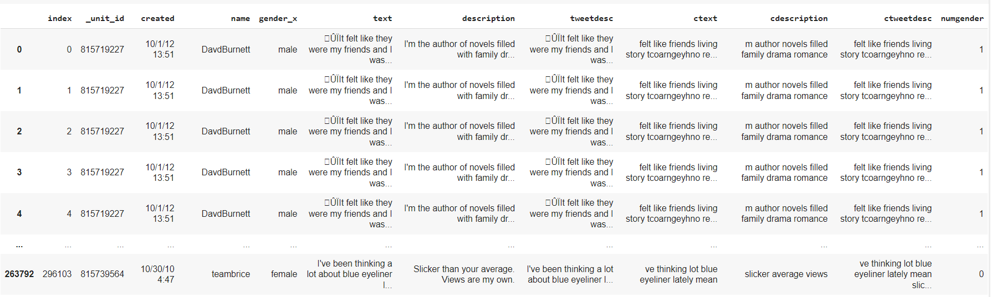
Converting gender values to numeric:
data['numgender'] = data['gender_x'].map({'male': 1,'female': 0})
#Output:

Slide 31
Dividing data for training and testing:
from sklearn.model_selection import train_test_split
X_traina, X_testa, y_traina, y_testa = train_test_split(data.ctext, data.numgender, test_size=0.35,random_state=42 )
X_trainb, X_testb, y_trainb, y_testb = train_test_split(data.ctweetdesc, data.numgender, test_size=0.35,random_state=42 )
X_trainc, X_testc, y_trainc, y_testc = train_test_split(data.cdescription, data.numgender, test_size=0.35,random_state=42 )

Slide 32
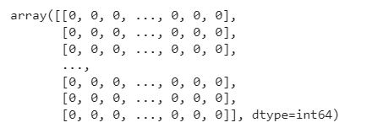
NLP Models
1. Bag of Words(BOW)
from sklearn.feature_extraction.text import CountVectorizer
v = CountVectorizer()
X_train_cv1 = v.fit_transform(X_traina.values)
X_train_cv2 = v.fit_transform(X_trainb.values)
X_train_cv3 = v.fit_transform(X_trainc.values)
X_train_cv1.toarray()
X_train_cv2.toarray()
X_train_cv3.toarray()
X_test_cv1 = v.transform(X_testa)
X_test_cv2 = v.transform(X_testb)
X_test_cv3 = v.transform(X_testc)

Slide 33
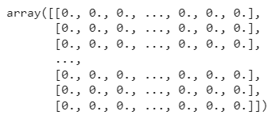
2. TF-IDF
from sklearn.feature_extraction.text import TfidfVectorizer
v = TfidfVectorizer()
X_train_cv1 = v.fit_transform(X_traina.values)
X_train_cv2 = v.fit_transform(X_trainb.values)
X_train_cv3 = v.fit_transform(X_trainc.values)
X_train_cv1.toarray()
X_train_cv2.toarray()
X_train_cv3.toarray()
X_test_cv1 = v.transform(X_testa)
X_test_cv2 = v.transform(X_testb)
X_test_cv3 = v.transform(X_testc)

Slide 34
3. GLOVE
from gensim.scripts.glove2word2vec import glove2word2vec
from gensim.models import KeyedVectors
glove_input_file = 'glove.6B.300d.txt'
glove_output_file = 'word2vec.txt'
glove2word2vec(glove_input_file,glove_output_file)
model = KeyedVectors.load_word2vec_format(glove_output_file,binary=False)
def preprocess_text1(text):
tokens = text.split()
word_vectors_list = []
for token in tokens:
if token in model:
word_vectors_list.append(model[token])

Slide 35
if len(word_vectors_list) > 0:
return np.mean(word_vectors_list, axis=0)
else:
return np.zeros(model.vector_size)

Slide 36
4. BERT
from transformers import BertTokenizer, BertModel
tokenizer = BertTokenizer.from_pretrained('bert-base-uncased')
bert_model = BertModel.from_pretrained('bert-base-uncased’)
data1.drop(data1[data1['cdescription']==''].index, inplace = True)
data1['ctext1'] = data1['ctext'].apply(extract_bert_embeddings)
data1['ctweetdesc1'] = data1['ctweetdesc'].apply(extract_bert_embeddings)
data1['cdescription1'] = data1['cdescription'].apply(extract_bert_embeddings)

Slide 37
5.Word to Vector(W2V)
from nltk.tokenize import word_tokenize
from gensim.models import Word2Vec
word2vec_model1 = Word2Vec(sentences=data1['ctext1'], vector_size=100, window=5, min_count=1, workers=4)
word2vec_model2 = Word2Vec(sentences=data1['ctweetdesc1'], vector_size=100, window=5, min_count=1, workers=4)
word2vec_model3 = Word2Vec(sentences=data1['cdescription1'], vector_size=100, window=5, min_count=1, workers=4)
def average_word_vectors(words, model, vocabulary, num_features):
feature_vector = np.zeros((num_features,), dtype="float64")
nwords = 0. for word in words:
if word in vocabulary:
nwords = nwords + 1.
feature_vector = np.add(feature_vector, model.wv[word]) if nwords:
feature_vector = np.divide(feature_vector, nwords) return feature_vector

Slide 38
6. GPT2
from transformers import GPT2Tokenizer, GPT2Model
import torch
tokenizer = GPT2Tokenizer.from_pretrained("gpt2")
data1['ctext1'] = data1['ctext'].apply(generate_text_embeddings)
data1['ctweetdesc1'] = data1['ctweetdesc'].apply(generate_text_embeddings)
data1['cdescription1'] = data1['cdescription'].apply(generate_text_embeddings)

Slide 39
Machine Learning Models
1. Naïve Bayes Classifier
from sklearn.naive_bayes import MultinomialNB
model = MultinomialNB() # instantiate the model
model.fit(X_train_cv1, y_traina) #fit the model with data
model.fit(X_train_cv2, y_trainb)
model.fit(X_train_cv3, y_trainc)
from sklearn.metrics import accuracy_score
from sklearn.metrics import classification_report
y_pred1 = model.predict(X_test_cv1) #Predict the response for test dataset
y_pred2 = model.predict(X_test_cv2)
y_pred3 = model.predict(X_test_cv3)
l=[]
m=[]
n=[]

Slide 40
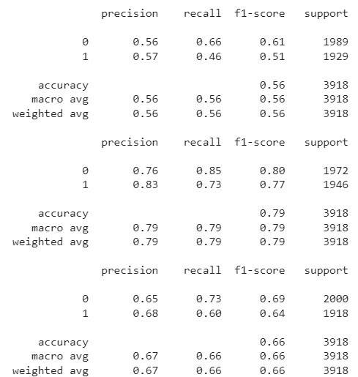
l.append(accuracy_score(y_testa, y_pred1) * 100)
m.append(accuracy_score(y_testb, y_pred2) * 100)
n.append(accuracy_score(y_testc, y_pred3) * 100)
print(classification_report(y_testa, y_pred1)) # Print Classificaion report
print(classification_report(y_testb, y_pred2))
print(classification_report(y_testc, y_pred3))
#Output:

Slide 41
2. Logistic Regression
from sklearn.linear_model import LogisticRegression
# instantiate the model (using the default parameters)
logreg = LogisticRegression()
# fit the model with data
logreg.fit(X_train_cv1, y_traina)
logreg.fit(X_train_cv2, y_trainb)
logreg.fit(X_train_cv3, y_trainc)
#Predict the response for test dataset
y_pred1 = logreg.predict(X_test_cv1)
y_pred2 = logreg.predict(X_test_cv2)
y_pred3 = logreg.predict(X_test_cv3)
l.append(accuracy_score(y_testa, y_pred1) * 100)
m.append(accuracy_score(y_testb, y_pred2) * 100)
n.append(accuracy_score(y_testc, y_pred3) * 100)

Slide 42
3. Decision Tree:
from sklearn.tree import DecisionTreeClassifier
# instantiate the model
clf = DecisionTreeClassifier()
#fit the model with data
clf1 = clf.fit(X_train_cv1,y_traina)
clf2 = clf.fit(X_train_cv2,y_trainb)
clf3 = clf.fit(X_train_cv3,y_trainc)
#Predict the response for test dataset
y_pred1 = clf.predict(X_test_cv1)
y_pred2 = clf.predict(X_test_cv2)
y_pred3 = clf.predict(X_test_cv3)
l.append(accuracy_score(y_testa, y_pred1) * 100)
m.append(accuracy_score(y_testb, y_pred2) * 100)
n.append(accuracy_score(y_testc, y_pred3) * 100)

Slide 43
4. Random Forest:
from sklearn.ensemble import RandomForestClassifier
# instantiate the model
rf = RandomForestClassifier()
#fit the model with data
rf.fit(X_train_cv1, y_traina)
rf.fit(X_train_cv2, y_trainb)
rf.fit(X_train_cv3, y_trainc)
#Predict the response for test dataset
y_pred1 = rf.predict(X_test_cv1)
y_pred2 = rf.predict(X_test_cv2)
y_pred3 = rf.predict(X_test_cv3)
l.append(accuracy_score(y_testa, y_pred1) * 100)
m.append(accuracy_score(y_testb, y_pred2) * 100)
n.append(accuracy_score(y_testc, y_pred3) * 100)

Slide 44
5. Support Vector Machine:
#Import svm model
from sklearn import svm
clf = svm.SVC(kernel='linear') # Linear Kernel
#Train the model using the training sets
clf.fit(X_train_cv1, y_traina)
clf.fit(X_train_cv2, y_trainb)
clf.fit(X_train_cv3, y_trainc)
#Predict the response for test dataset
y_pred1 = clf.predict(X_test_cv1)
y_pred2 = clf.predict(X_test_cv2)
y_pred3 = clf.predict(X_test_cv3)
l.append(accuracy_score(y_testa, y_pred1) * 100)
m.append(accuracy_score(y_testb, y_pred2) * 100)
n.append(accuracy_score(y_testc, y_pred3) * 100)

Slide 45
6. Bagging:
from sklearn.ensemble import BaggingClassifier
from sklearn.tree import DecisionTreeClassifier
tree = DecisionTreeClassifier(random_state = 0)
bag = BaggingClassifier(base_estimator=tree,n_estimators=100,random_state=0)
bag.fit(X_train_cv1, y_traina)
bag.fit(X_train_cv2, y_trainb)
bag.fit(X_train_cv3, y_trainc)
y_pred1 = bag.predict(X_test_cv1)
y_pred2 = bag.predict(X_test_cv2)
y_pred3 = bag.predict(X_test_cv3)
l.append(accuracy_score(y_testa, y_pred1) * 100)
m.append(accuracy_score(y_testb, y_pred2) * 100)
n.append(accuracy_score(y_testc, y_pred3) * 100)

Slide 46
7. VCH:
from sklearn.linear_model import LogisticRegression
from sklearn.svm import SVC
from sklearn.tree import DecisionTreeClassifier
estimator = []
estimator.append(('LR', LogisticRegression(solver ='lbfgs', multi_class ='multinomial', max_iter = 200)))
estimator.append(('SVC', SVC(gamma ='auto', probability = True)))
estimator.append(('DTC', DecisionTreeClassifier()))
from sklearn.ensemble import VotingClassifier
# instantiate the model
vot_hard = VotingClassifier(estimators = estimator,voting='hard’)
#fit the model with data
vot_hard.fit(X_train_cv1, y_traina)
vot_hard.fit(X_train_cv2, y_trainb)
vot_hard.fit(X_train_cv3, y_trainc)

Slide 47

#output:
#Predict the response for test dataset
y_pred1 = vot_hard.predict(X_test_cv1)
y_pred2 = vot_hard.predict(X_test_cv2)
y_pred3 = vot_hard.predict(X_test_cv3)
l.append(accuracy_score(y_testa, y_pred1) * 100)
m.append(accuracy_score(y_testb, y_pred2) * 100)
n.append(accuracy_score(y_testc, y_pred3) * 100)

Slide 48
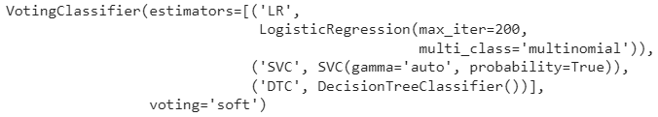
8. VCS:
from sklearn.ensemble import VotingClassifier
vot_soft = VotingClassifier(estimators = estimator,voting='soft’)
vot_soft.fit(X_train_cv1, y_traina)
vot_soft.fit(X_train_cv2, y_trainb)
vot_soft.fit(X_train_cv3, y_trainc)
#Output:
y_pred1 = vot_soft.predict(X_test_cv1)
y_pred2 = vot_soft.predict(X_test_cv2)
y_pred3 = vot_soft.predict(X_test_cv3)

Slide 49
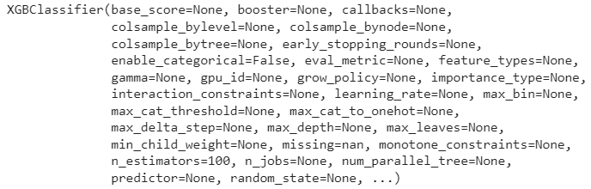
9. XGB:
from xgboost import XGBClassifier
model = XGBClassifier()
model.fit(X_train_cv1, y_traina)
model.fit(X_train_cv2, y_trainb)
model.fit(X_train_cv3, y_trainc)
#Output:
y_pred1 = model.predict(X_test_cv1)
y_pred2 = model.predict(X_test_cv2)
y_pred3 = model.predict(X_test_cv3)

Slide 50
Results:
Plotting graph:
import matplotlib.pyplot as plt
import numpy as np
l1=np.array(l)
m1=np.array(m)
n1=np.array(n)
names = ["NBC","LR","DT","RF","SVM","Bagging","VCH","VCS","XGB"]
plt.plot(l1,label="Tweets",marker='o',color='blue')
plt.xticks(l1, names)
plt.plot(m1,label="TweetsDesc",marker='s',color='red')
plt.plot(n1,label="Desc",marker='s',color='green')
plt.legend()
plt.show()

Slide 51
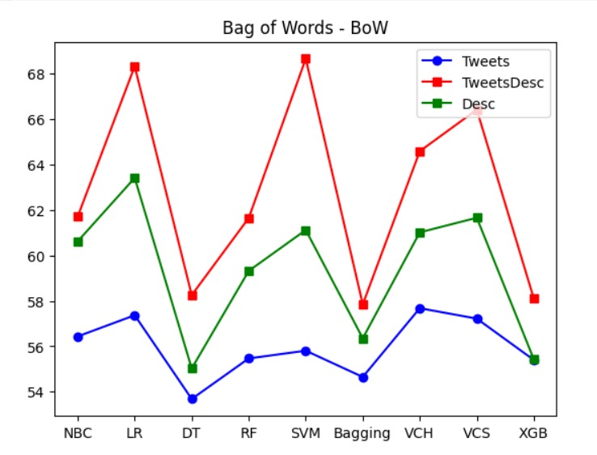
Bag of Words(BOW):

Slide 52
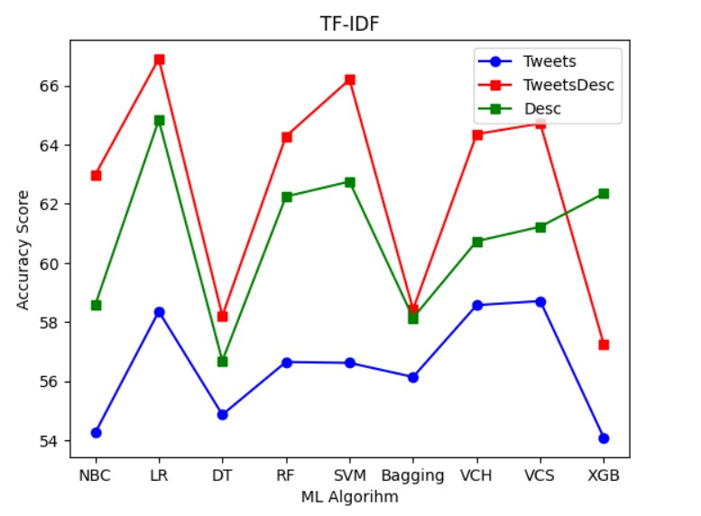
TF-IDF:

Slide 53
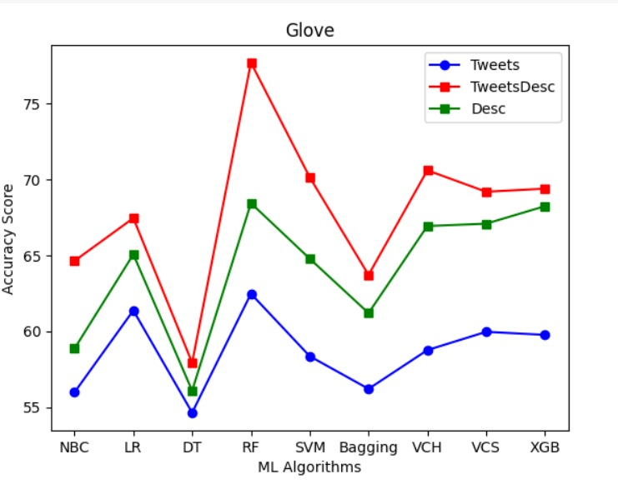
GLOVE:

Slide 54
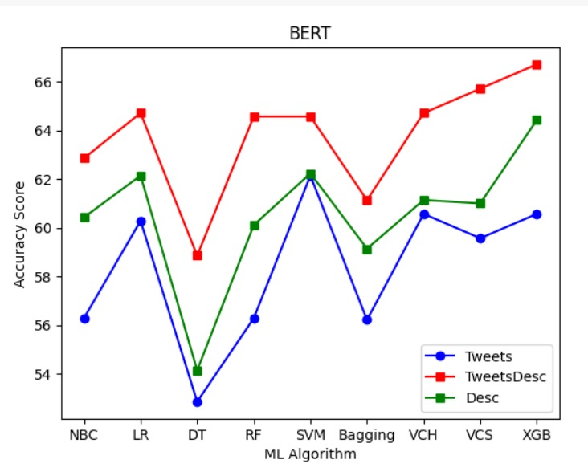
BERT:

Slide 55
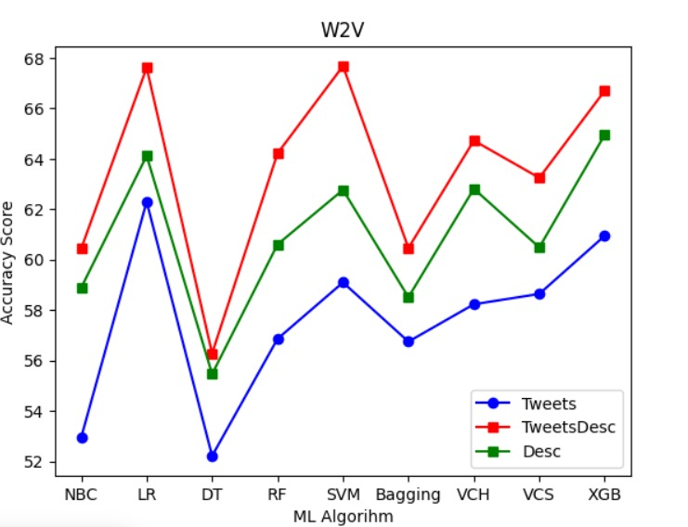
W2V:

Slide 56
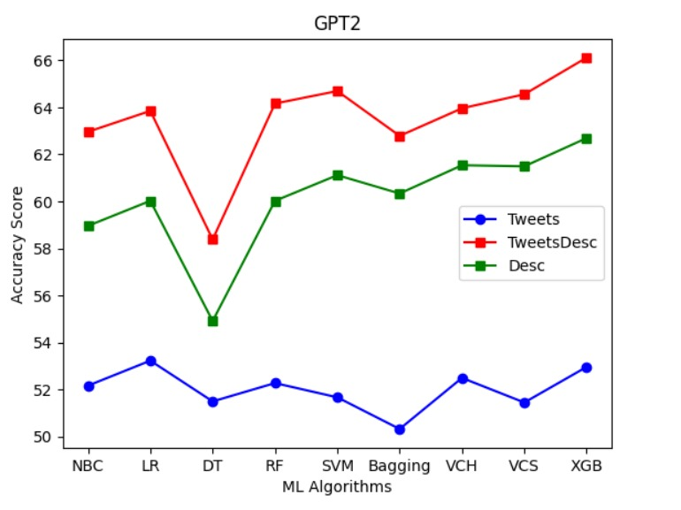
GPT2:

Slide 57
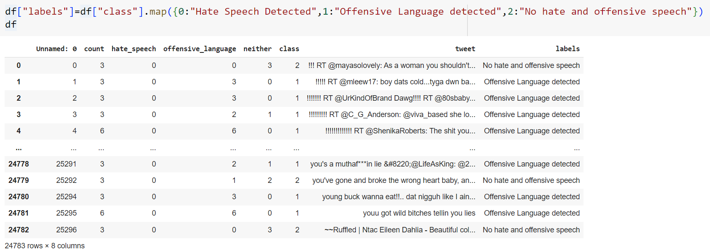
b)Hate Speech Detection

Slide 58
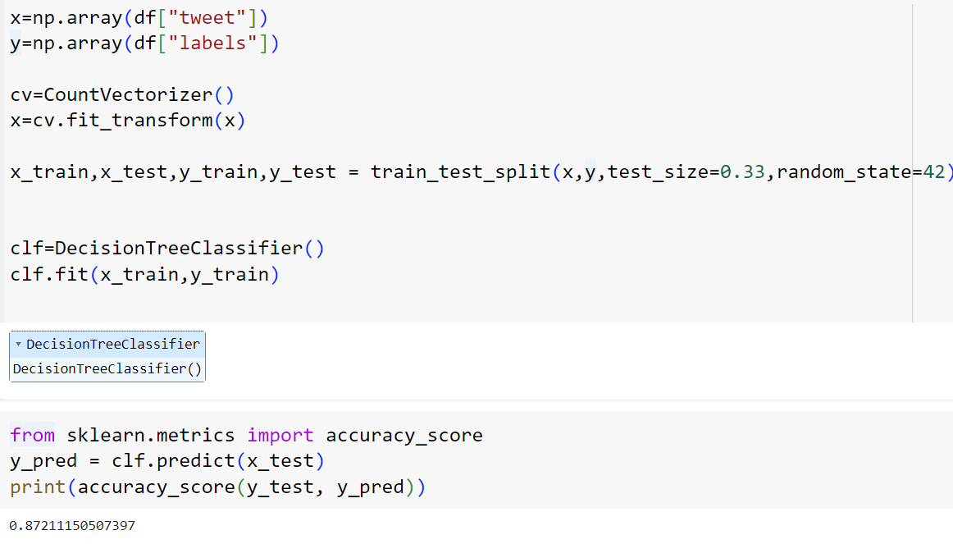

Slide 59
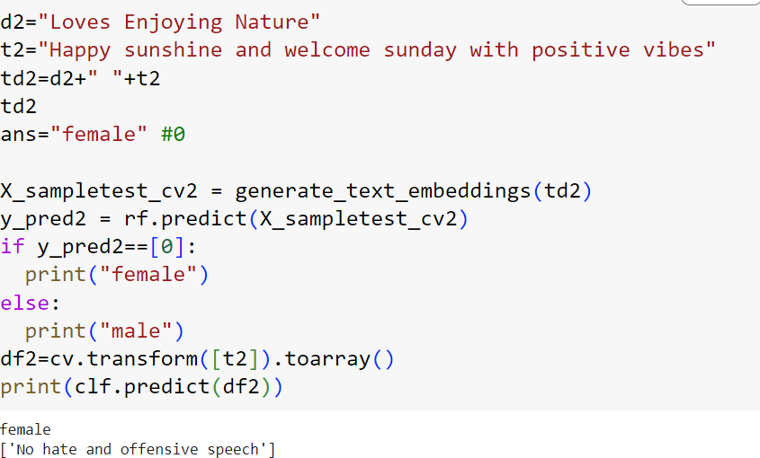
Test Cases

Slide 60
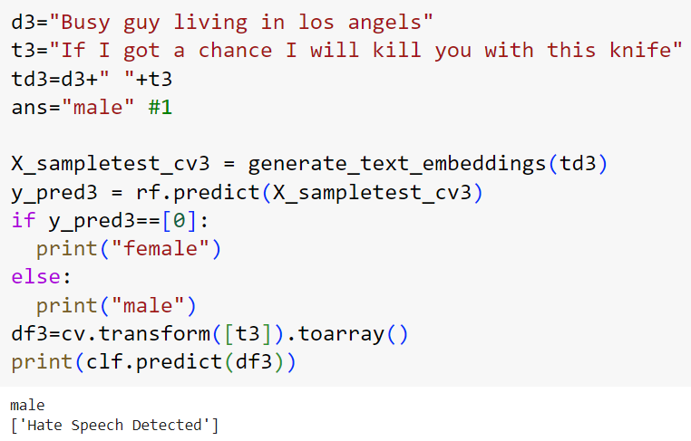

Slide 61
Conclusion
For gender prediction high accuracy is obtained for the combination of GloVe and Random Forest which is around 80%.
For hate speech detection the accuracy is around 87%.
Model will successfully predict gender and hate speech for the new real-world tweets.

Slide 62


